Slide 1
Sleeping Better in a Connected World
SENSING AND INTERNET OF THINGS COURSEWORK
By Rosie Davies
https://github.com/Rosiedabomb/SIOT_COURSEWORK

Slide 2
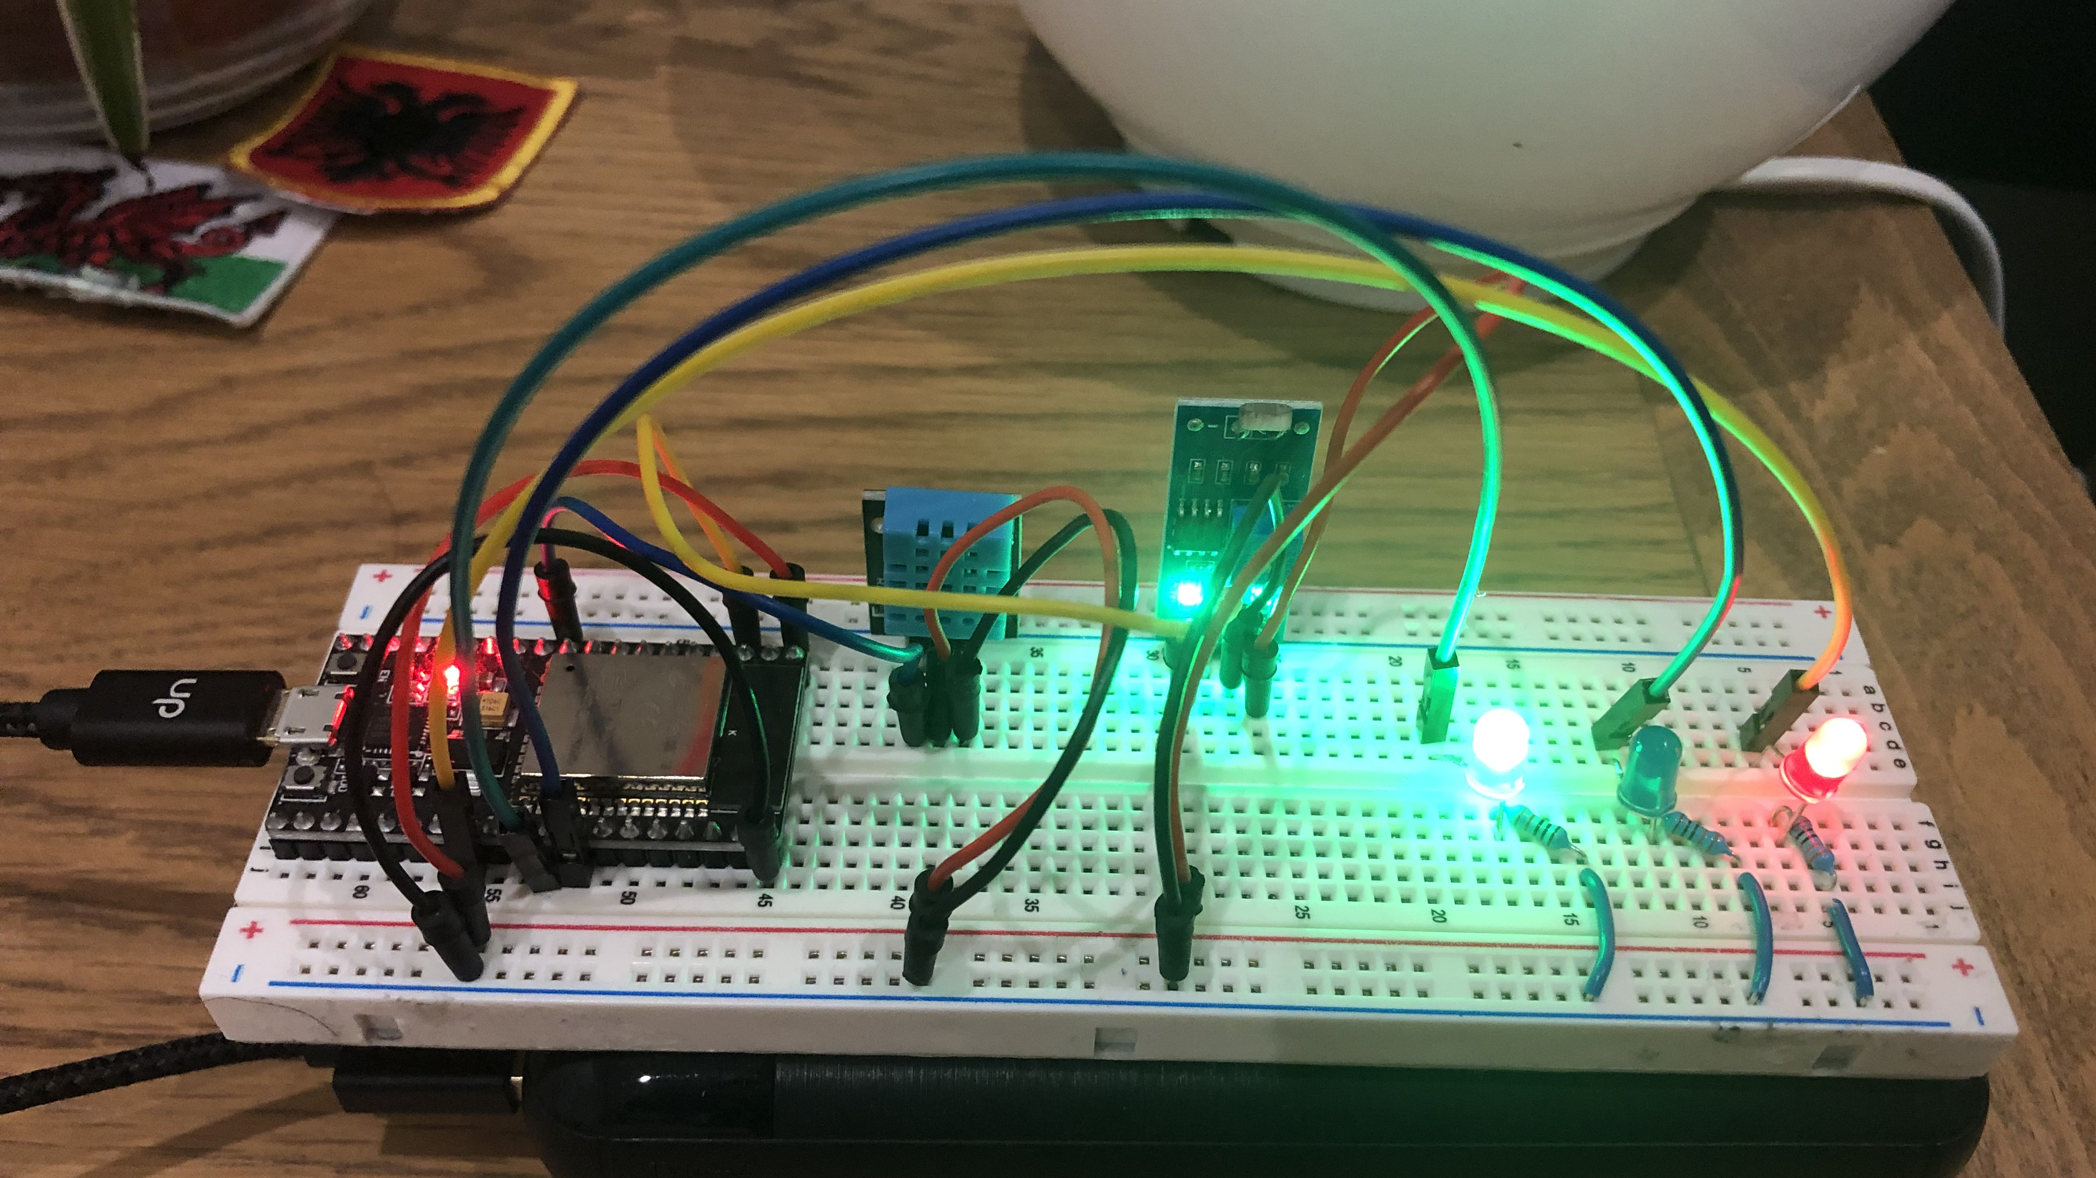
Hardware:
Photoresistor (LDR) sensor module
DHT11 sensor module
LEDs
ESP32 Dev Board
330Ω resistors
2000mAh Power Bank

Slide 3
Functionality
Senses Light level
Senses Temperature
On/off Red, Green, Blue LEDs
Wifi enabled

Slide 4


System Overview
User
Client (My laptop)
Router (internet)
LED on/off
Mosquitto
MQTT Broker
MQTT protocol Topic Data(temp : 19.2)
Temperature
ESP32 sensor node
Node Red IOT tool
Light Level
User

Slide 5
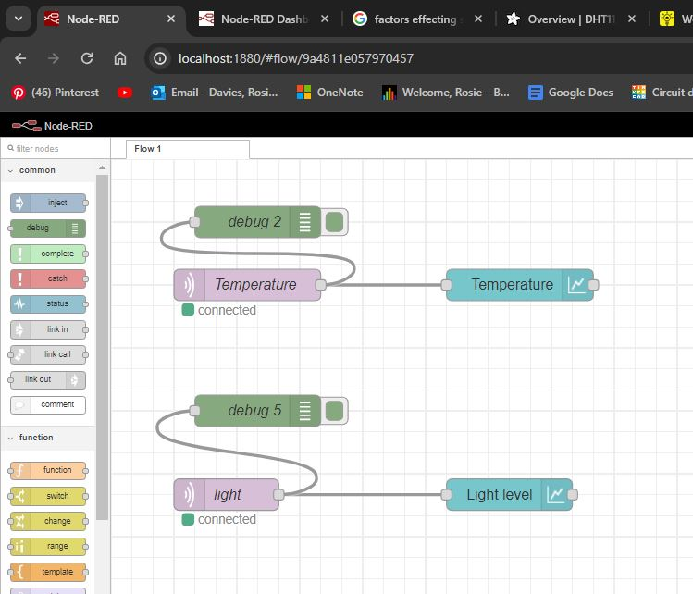
Networking
Comms via Wifi router to laptop
MQTT broker on my Laptop
Subscribes to two topics: Light & Temperature

Slide 6
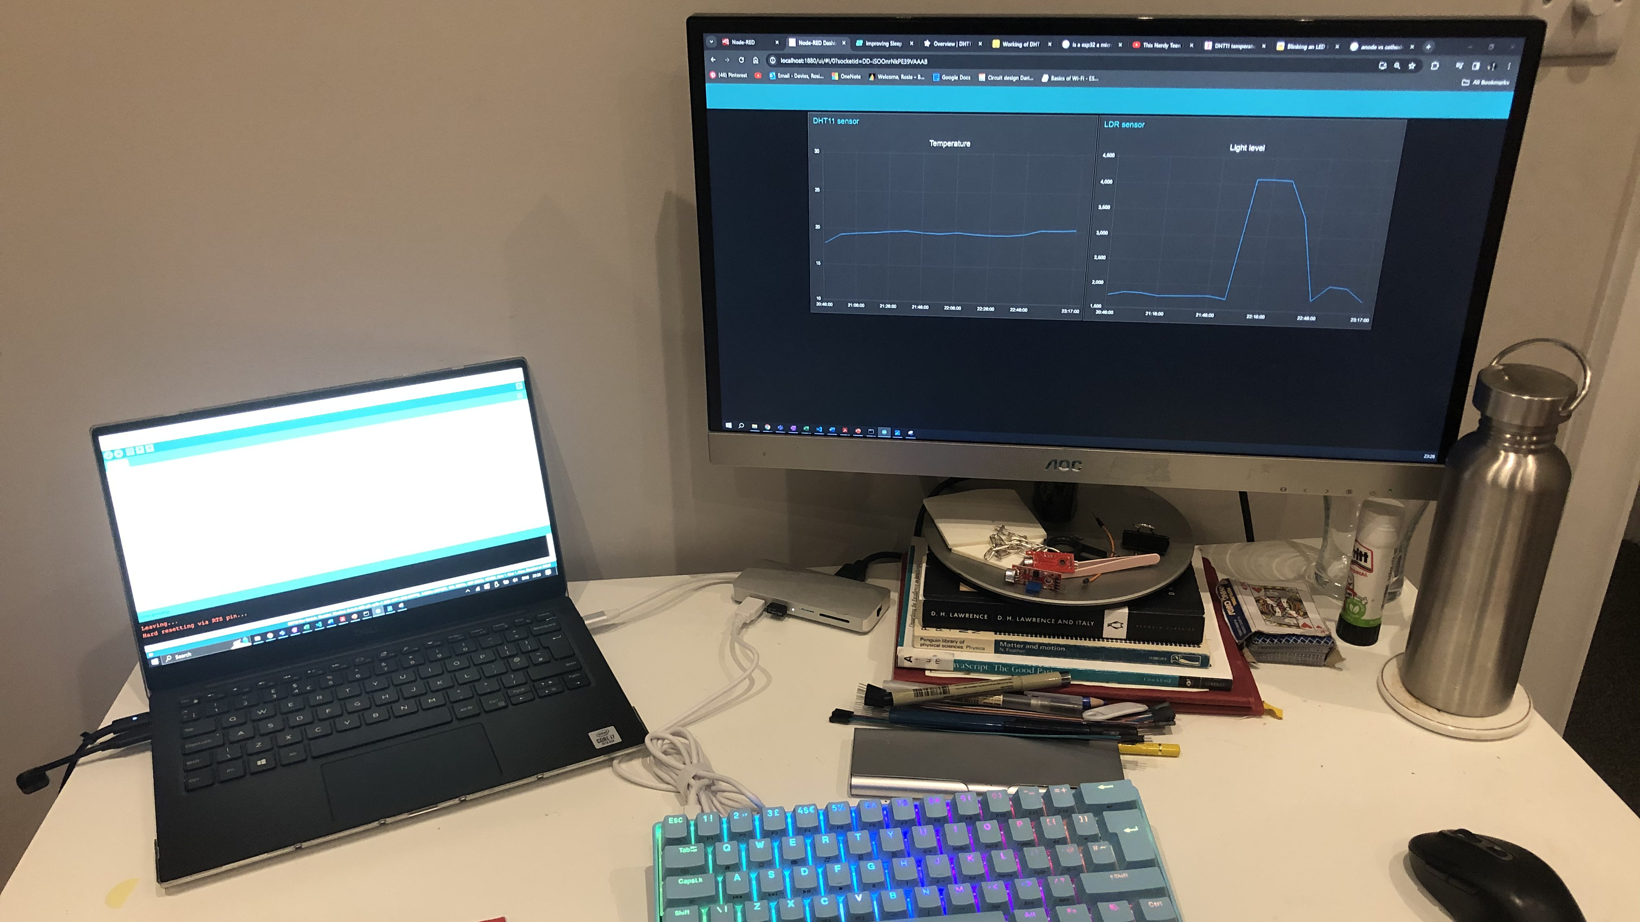
Data display
Using Node red, displays incoming data on a local host in the browser
Graphically displays this data with built in interface

Slide 7
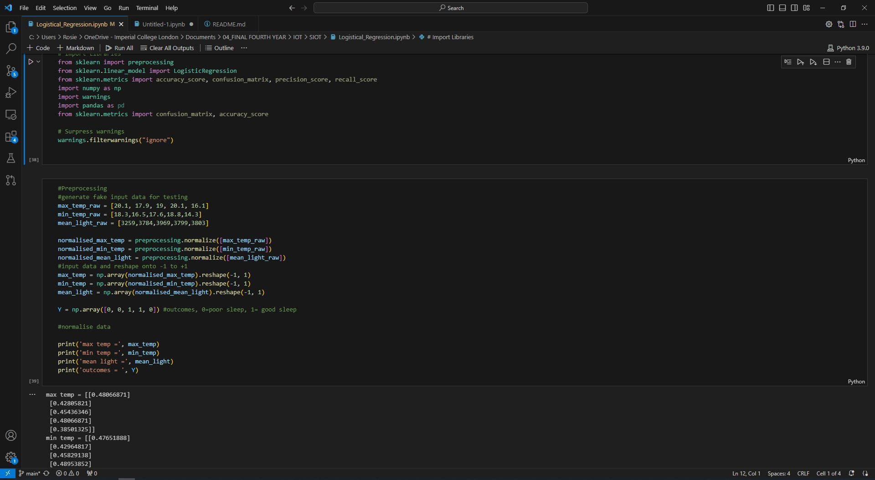
Data Analysis/fusion
Combined sensor data + User data
Used Jupyter Notebook to analyse data, perform Logistical regression.

Slide 8
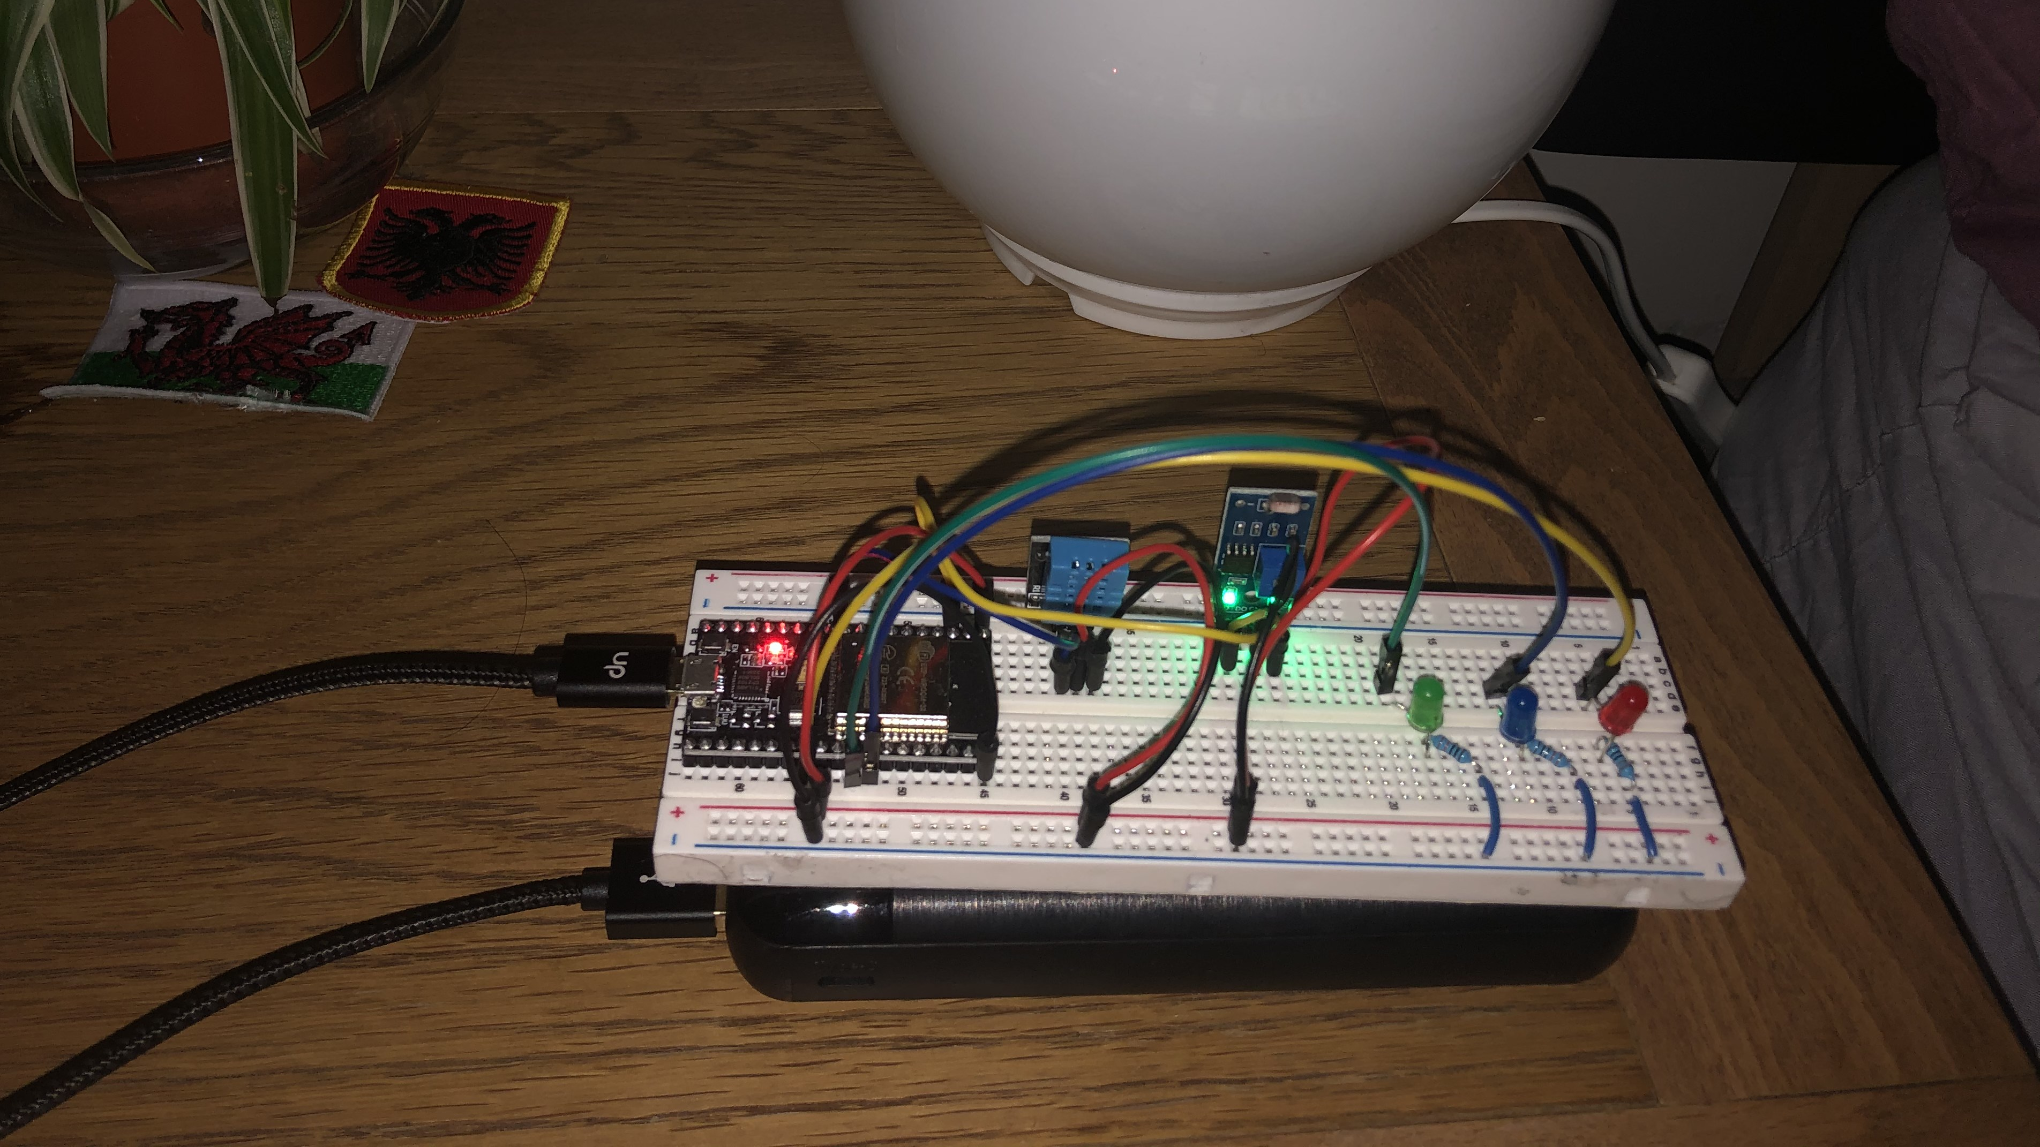
Interaction/response
When the temperature is too high > RED LED
When temperature is too low >BLUE LED
When Light level is too high > GREEN LED

